Slide 1
Welcome
Presented By:
Joanna Damianakis - z5162567
Cameron Read - z5113915
Daniel Kimber - z5162319
Ethan Whitehouse - z5160339
Carlos Perez - z5162599

Slide 2
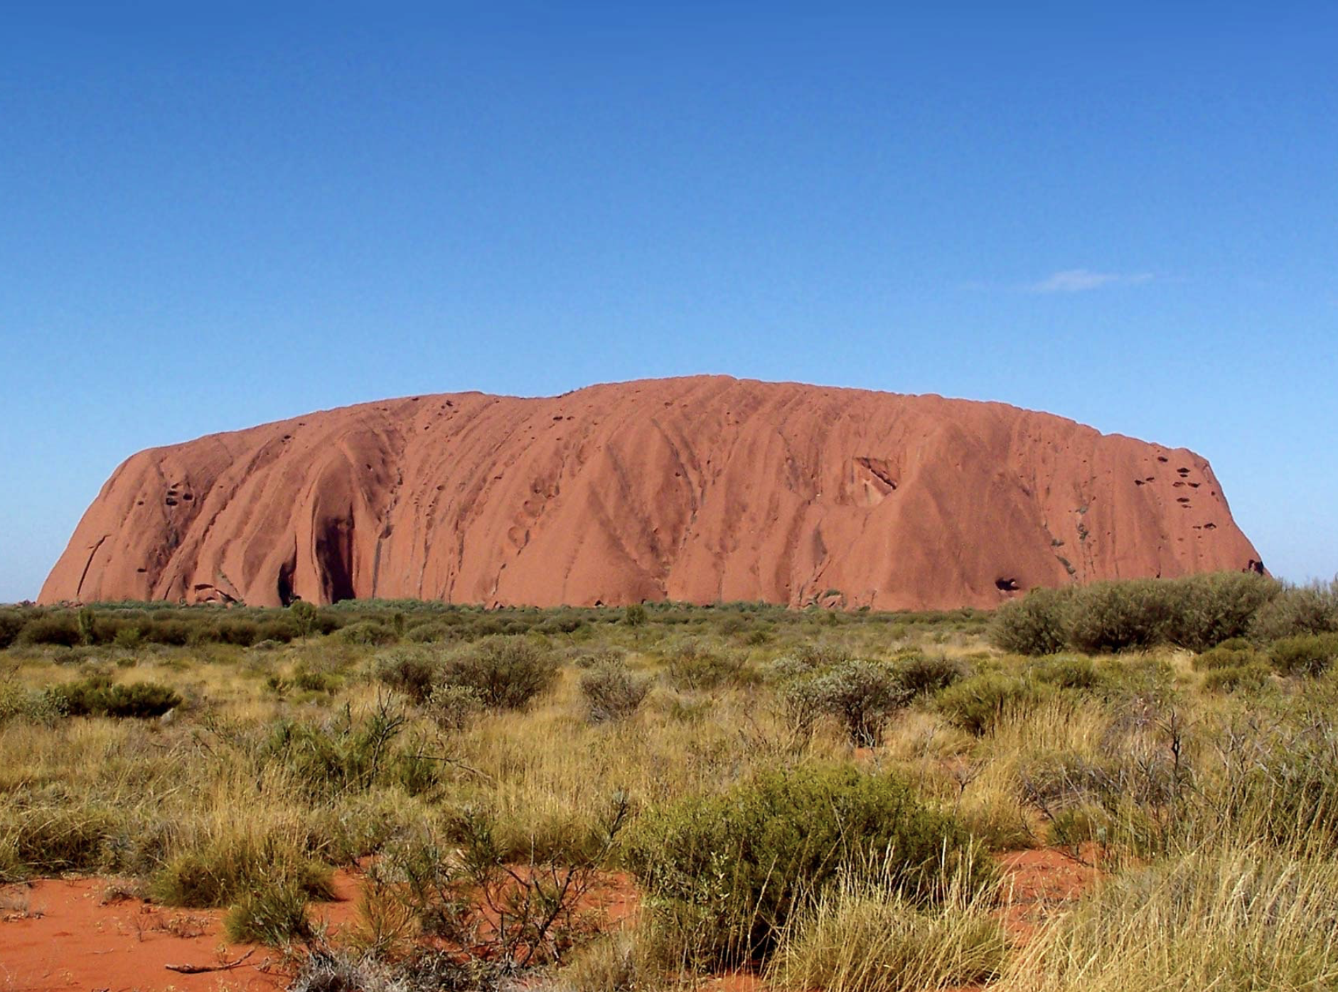
Objectives
Collation and storage of data relating to multi-destination trips hosted by ‘Outback Explorer’
Project seeks to rectify problems relating to missing or incorrect data
Database to meet industry standards
Factors have been taken into consideration, to factor for Outback Explorers operations
Take into account large capital and labour reserves required to undertake these geographically broad operations

Slide 3
Scope
Database seeks to establish a system which can collect data relating to the following:
Planes used by ‘Outback Explorer’ (OE) The crew employed by OE Employees The Supervisor assigned to each given flight Multi-Destination Trips Flight information Passenger information | Payment method and information Booking information Airports involved in trips, and their facilities (nature of facility also) Feedback from Passengers Suppliers Products received by OE

Slide 4
Limitations
Factors inhibiting the ability to map out data accurately for OE:
Plane fuel limitations Capacity Limits Crew member availability Limits of trip conditions: Seasonal Factors Airport availability Supplier Condition Internal business financing Destination tour availability | Employee performance Shipment Progress Accuracy of information from Airports Condition of airports/facilities Changing nature of customer information Functionality of payment systems Customer satisfaction- Feedback Functionality of booking systems Reliability of software used Application Performance System Vulnerability DBMS costs

Slide 5
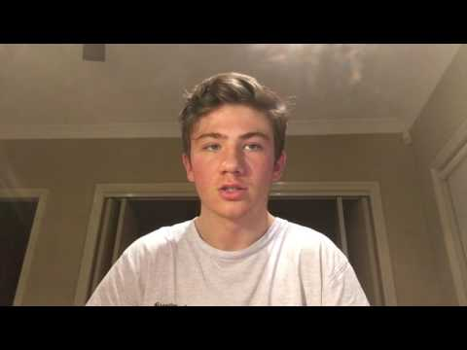

Slide 6
Entity - Relationship Diagram
1
Visual diagram and Description

Slide 7
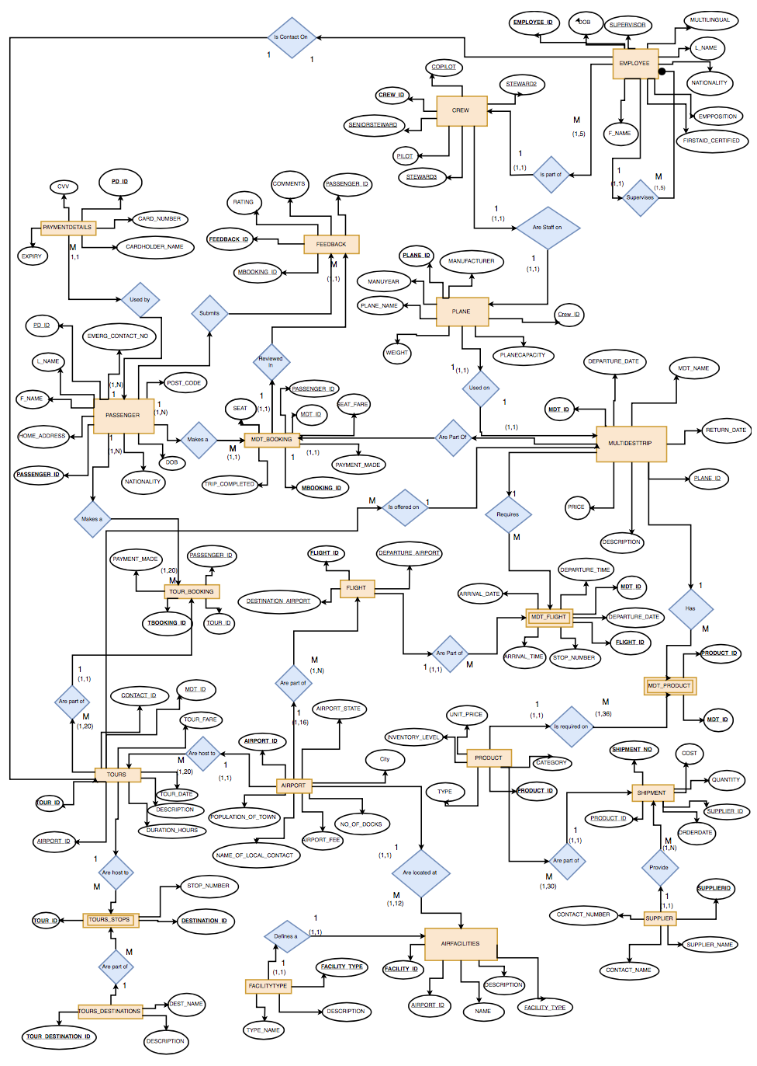

Slide 9
Relational Schema
2
Visual Diagram and Description

Slide 10
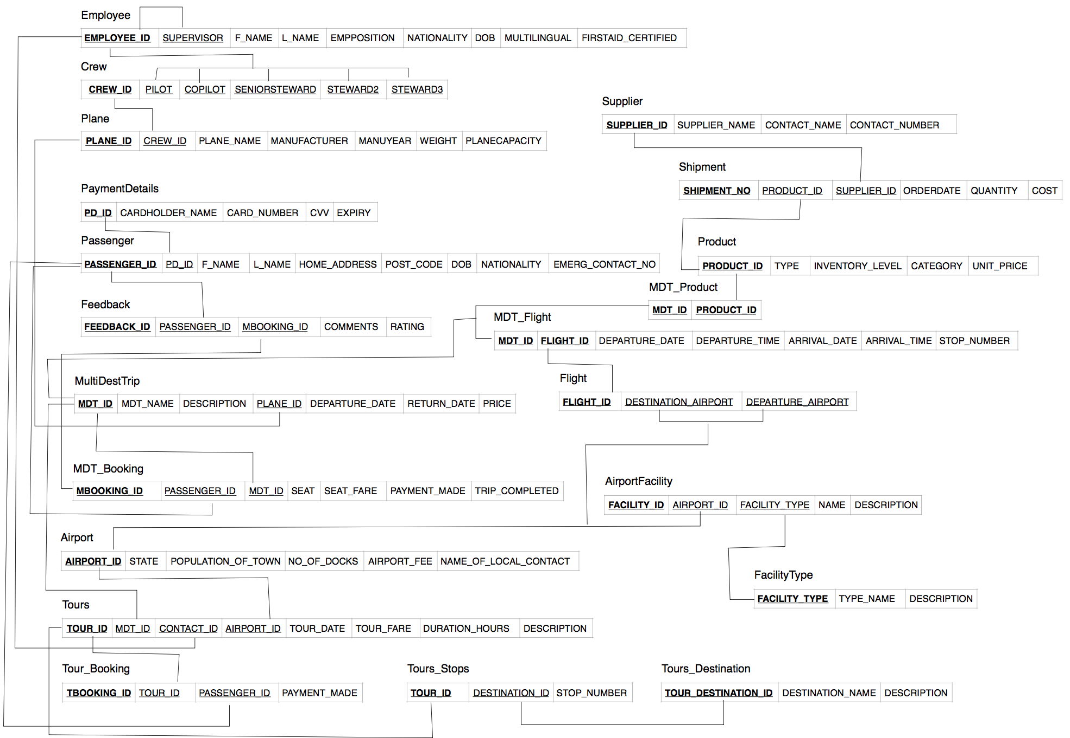
Want big impact?
USE BIG IMAGE

Slide 11
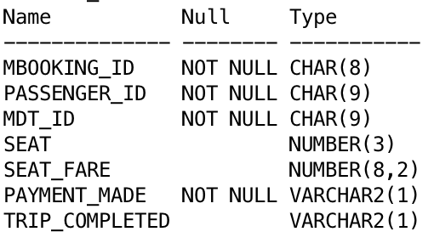
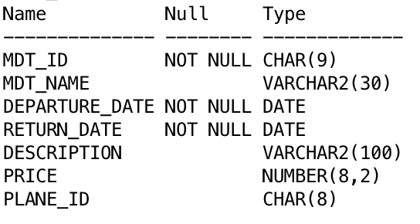
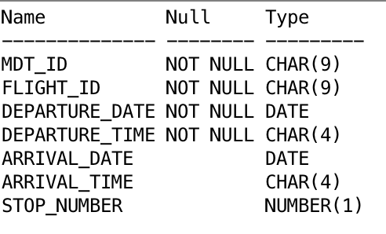

Slide 12
Issues and Ethical Considerations
Considered to ensure database integrity
Risks include administrative issues - absenteeism
Crew member crucial, only assigned to one plane at a time
Changing consumer information
Understaffing - staff overwhelmed
Staff training needed to use system - technological divide possible
Some staff may not be able to understand the change- feel uncertain
Reliability of tour companies, product suppliers and airports
Condition of planes crucial
Adverse flying/weather conditions
Adequate allocation of staff

Slide 13
Possible Improvements
Crew table, a prime example
Establish a table that records past crews for tours
Security measures to protect customers and staff details
Payment details table needs protection
Firewall protection on computers
Better integration of companies packaged tour offers into overall product
Expansion of system so other types of data can be stored
Integration of company stock levels and supplier orders
System of validation of passenger payment details

Slide 14
THANKS!
Any questions?

Slide 15
CREDITS
Special thanks to all the people who made and released these awesome resources for free:
Presentation template by SlidesCarnival
Photographs by Startup Stock Photos

